Slide 1
Perimeter with composite rectilinear shapes
Perimeter and area

Slide 2
how to use Oak lessons

Slide 3
I can use the properties of a range of polygons to deduce the perimeters of compound shapes, including generalising a perimeter formula where appropriate.

Slide 4
A compound shape is a shape created using two or more basic shapes.
A composite shape is an alternative term for a compound shape.
A composite rectilinear shape is a composite shape made from rectangles.

Slide 5

Perimeter with composite rectilinear shapes
Strange staircases
More composite rectilinear shapes
Perimeter calculations

Slide 6
Strange staircases
Understanding perimeter means being able to reason with perimeter.
Identifying what is the same and what is different is an important skill for problem solving.

Slide 7
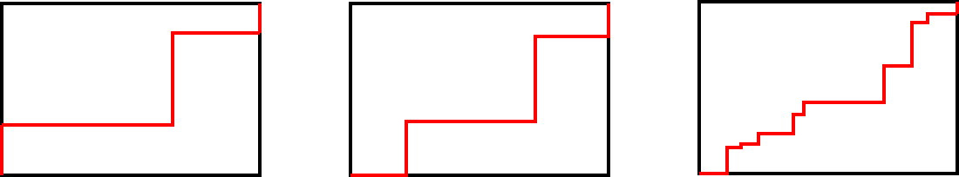
Strange staircases
1) The perimeter of each rectangle is 26 cm.
How long is the red line each time?
a) b) c)
Justify your answer.

Slide 8
Strange staircases
1) The perimeter of each rectangle is 26 cm.
How long is the red line each time? 13 cm
a) b) c)
Justify your answer. Let’s consider a)

Slide 9
Strange staircases
1) The perimeter of each rectangle is 26 cm.
How long is the red line each time? 13 cm
a)
Let’s consider what would happen if all the vertical lines moved to the right and all the horizontal lines moved down.

Slide 10
Strange staircases
1) The perimeter of each rectangle is 26 cm.
How long is the red line each time? 13 cm
a)
The red line is one length and one width of the rectangle. It is half the perimeter.

Slide 11
Strange staircases
Why does this approach of ‘moving’ the lines also work for b) and c) ?
a) b) c)
The red lines are made of vertical and horizontal lines that do not overlap.

Slide 12
Strange staircases
Some composite rectilinear shapes can be easily rearranged to form a rectangle.
Rearranging the sides in this way does not change the perimeter.

Slide 13
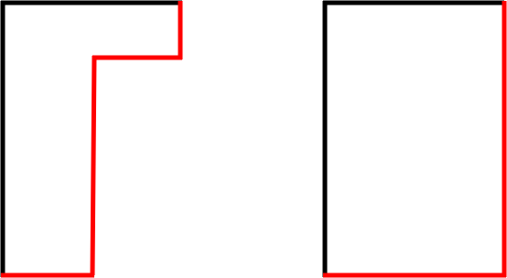
Strange staircases
Some composite rectilinear shapes can be easily rearranged to form a rectangle.
Rearranging the sides in this way does not change the perimeter.

Slide 14
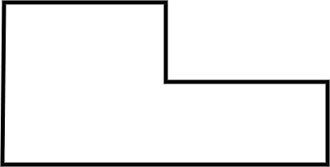

Strange staircases
Calculate the perimeter of the shape.
5.7 m
15 m
5 m
23.3 m
2.6 m
30 m
10 m

Slide 15
Perimeter with composite rectilinear shapes
Strange staircases
More composite rectilinear shapes
Perimeter calculations

Slide 16
More composite rectilinear shapes
Some composite rectilinear shapes can be easily rearranged to form a rectangle.
This is not always the easiest method though.

Slide 17
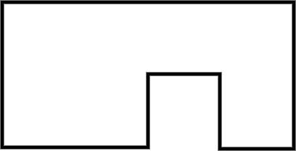
More composite rectilinear shapes
2
4
1) Try to rearrange these sides to create a rectangle.
Evaluate how easy this is to do.
3
6
8

Slide 18
More composite rectilinear shapes
2
4
1) Try to rearrange these sides to create a rectangle.
Evaluate how easy this is to do.
3
6
8

Slide 19
More composite rectilinear shapes

Slide 20

More composite rectilinear shapes
It is possible to rearrange but this is not easy to see because the sides to move overlap each other.
2
4
3
3
3
6
6
8
8

Slide 21
More composite rectilinear shapes
For some shapes, it may be easier to sum the sides.
Perimeter = 6 + 8 + 6 + 4 + 3 + 2 + 3 + 2 = 34 units
2
4
3
3
6
6
2
8

Slide 22
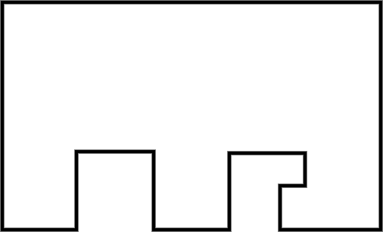
More composite rectilinear shapes
Which method would you look to use to find the perimeter of this shape? State your reasoning.
E.g.
I would want to sum all the sides because this shape is not simple to rearrange.

Slide 23
Perimeter with composite rectilinear shapes
Strange staircases
More composite rectilinear shapes
Perimeter calculations

Slide 24
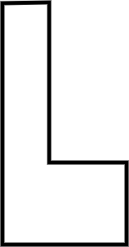

Perimeter calculations
Calculate the perimeter.
Calculate the perimeter.
4.8 in
7.4 cm
3 in
0.7 in
2.8 cm
4.6 in
4.3 cm
Perimeter = 2 × (7.4 + 2.8 + 4.3)
= 29 cm
Perimeter = 2 × (4.8 + 3)
= 15.6 in

Slide 25

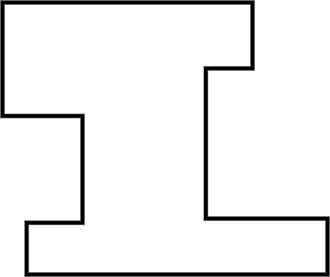
Perimeter calculations
1) Calculate the perimeter.
a) b)
17
11.1 m
2
3.2 m
23
14
0.6 m
2
5
19

Slide 26
Perimeter calculations
1) Calculate the perimeter.
a)
Perimeter = 2 × (11.1 + 0.6 + 3.2)
= 29.8 m
11.1 m
3.2 m
0.6 m

Slide 27
Perimeter calculations
1) Calculate the perimeter.
b)
17
2
Perimeter = 23 × 2 + 17 + 2 + 5 + 19 + 2 + 3
= 94 units
23
14
2
5
19

Slide 28
Perimeter with composite rectilinear shapes
Some composite rectilinear shapes can be easily rearranged to form a rectangle.
Rearranging the sides in this way does not change the perimeter.
Sometimes it is easier to sum all of the side lengths.

Slide 29

© Oak National Academy 2024.
Produced in partnership with Mathematics in Education and Industry.
Licensed on the Open Government Licence v3.0, except where otherwise stated. See Oak terms and conditions.

